Slide 1

NEST Nurturing Excellence, Strengthening Talent. ABSTRACT SUBMISSION GUIDELINES

Slide 2
Problem Statement – #1
Semantic grouping of clinical studies for retrieval &
strategic insights
Team Name -riyabasu06
Riya Bose - KIIT(M-Tech)

Slide 3
Approach & methodology
Overview
Methodology
Framework / tools used
Designing clinical trial protocols requires insights from historical trials to avoid errors and improve efficiency. The challenge lies in finding the most relevant trials by matching unstructured textual data (e.g., study title, conditions, outcomes) across multiple dimensions.
We preprocess the datasets, normalize textual features, and create a consolidated field for relevance computation. Using TF-IDF vectorization and Cosine Similarity, we identify the top 10 most relevant trials for a given query, ensuring domain alignment and explainability.
Data Collection and Preprocessing:
Merged 5 datasets, PK = NCT Number.
Addressed missing values, duplicates, and unstructured text.
Preprocessed text fields (lowercase, stopword removal, stemming) for uniformity.
Normalized categorical fields (Phases, Age_group, Sex).
Variables:
Selected: Study Title, Conditions, Criteria, Primary/Secondary Outcome Measures, Interventions, Age_group, Sex.
Derived:
combined_text: Consolidates key text fields for similarity computation.
Simplified Age_group into a single label (child, adult, older_adult).
Accuracy Metrics:
Cosine Similarity Scores: Measure relevance of retrieved trials.
Frameworks/Libraries:
1. scikit-learn:
TF-IDF Vectorization and Cosine Similarity for numerical representation and similarity scoring.
Used for its simplicity and effective text representation capabilities.
2. pandas & NumPy:
For data cleaning, merging, and preprocessing.
3. NLTK & re:
For text preprocessing (stemming, stopword removal, and text normalization).
4. scipy:
For saving/loading sparse matrices (e.g., TF-IDF matrix).
These libraries provide efficient implementations for text preprocessing, feature extraction, and similarity computation, ensuring scalability and quick experimentation.

Slide 4
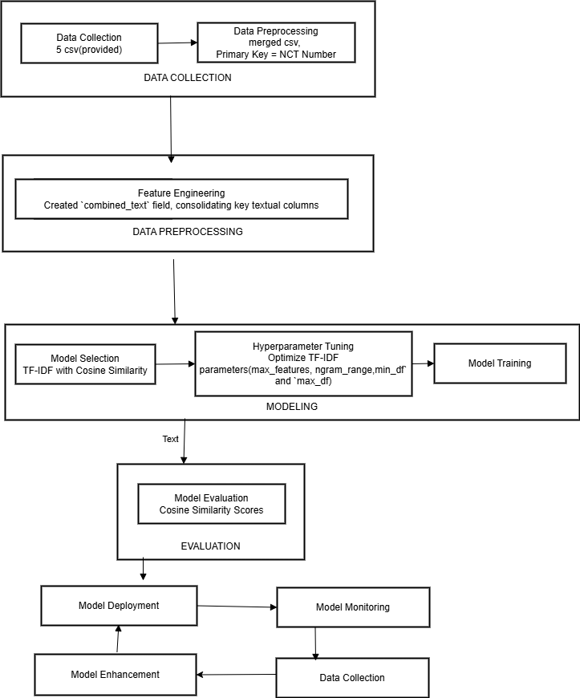
Model choice & setup
Model Selection
Model Architecture
Rationale for Choosing ML/AI Model
TF-IDF with Cosine Similarity:
TF-IDF: Converts text into numerical vectors by emphasizing unique terms while de-emphasizing common words, ideal for unstructured clinical trial data.
Cosine Similarity: Measures angular similarity, independent of text length, making it effective for comparing trials of varying descriptions.
Interpretability: Transparent scoring, crucial for clinical domain experts.
Efficiency: Focus on relevance retrieval rather than predictive modeling ensures simplicity and scalability.
Future Enhancements:
Embedding Models (e.g., BERT).
Neural Similarity Models
Provide a technical flow of the end-to-end ML pipeline

Slide 5
Model Training & Evaluation
Evaluation Metrics
Query Trial: NCT00385736
Top 10 Similar Trials:
NCT Number Similarity Score
NCT03844932 0.773888
NCT02601300 0.759906
NCT01506362 0.752483
NCT00853099 0.746655
NCT01863771 0.736856
NCT02499263 0.734978
NCT00487539 0.724151
NCT02289417 0.708091
NCT03281304 0.707666
NCT02065557 0.702187
Query Trial: NCT00386607
Top 10 Similar Trials:
NCT Number Similarity Score
NCT00787605 0.722069
NCT00333489 0.657251
NCT02620163 0.654872
NCT00797316 0.638468
NCT02433119 0.634403
NCT00368277 0.630540
NCT00927394 0.625478
NCT00311012 0.619136
NCT00389675 0.616289
NCT01828359 0.614445
Query Trial: NCT03518073
Top 10 Similar Trials:
NCT Number Similarity Score
NCT02791191 0.622304
NCT04640077 0.588933
NCT03367403 0.579799
NCT01127633 0.550369
NCT03443973 0.543305
NCT03444870 0.539967
NCT02580305 0.537472
NCT02008357 0.528250
NCT02972658 0.519753
NCT02477800 0.517970
Average Similarity Score for Queries: 0.643
Time Taken for Similarity Computation: 3.82 seconds

Slide 6
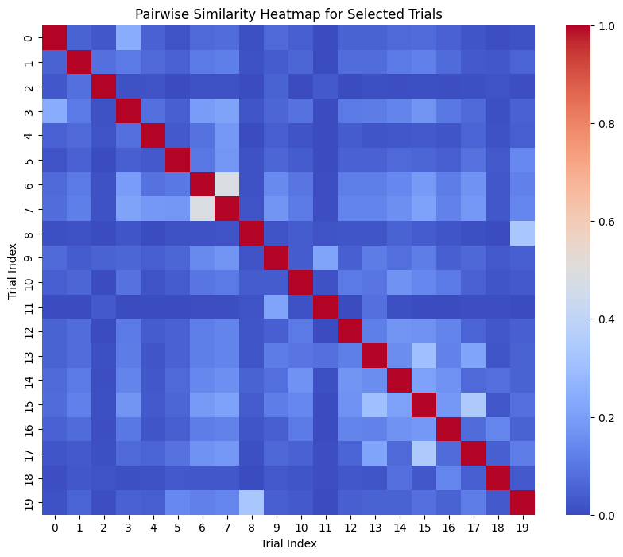
Results and visualization
Model Outcomes
Explainability
High Similarity Retrieval:
The model successfully retrieved 10 similar trials for each query trial (e.g., NCT00385736, NCT00386607, NCT03518073).
The average similarity score across queries was 0.643, indicating good relevance between retrieved trials and query trials.
The model took 3.82 seconds to compute similarities for a large dataset (~450,000 clinical trials), demonstrating scalability and computational efficiency.
Heatmap for Pairwise Similarity - Visualizes the similarity between a selected subset of trials (e.g., first 20 trials).
SHAP (SHapley Additive exPlanations) provides clear, additive feature attributions with Summary plots.[implemented in SemanticGrouping.ipynb, please find link below.]
GitHub link : https://github.com/riyabasu06/NEST-Semantic-grouping-of-clinical-studies

Slide 7
Challenges & Next Steps
Limitations
Next Steps
Key Caveats
Text Quality Dependence: Relies on fields like Study Title, Conditions, and Criteria. Poorly written or incomplete data can reduce accuracy.
Limited Context Understanding: TF-IDF fails to link semantically related terms (e.g., "diabetes" vs. "high blood sugar").
Lack of Hierarchical Insights: Misses relationships like neoplasm encompassing cancer, due to no ontology integration.
Model Limitations
Explainability Gaps: SHAP and TF-IDF weights may not fully align with domain-specific insights.
Static Vocabulary: Cannot adapt to new terms or evolving trial language.
Scalability: Computational cost grows with dataset size; challenges arise with millions of trials.
Potential Biases
Feature Overweighting: Conditions or Criteria may dominate; smaller features like Age_group get underrepresented.
Dataset Imbalance: Rare diseases or specific demographics may yield poor results due to lack of representation.
Remedies
Possible improvements:
Enhance Semantics: Use embeddings (e.g., BERT)
Add medical Ontologies for hierarchical insights.
Optimize Scaling by apply Approximate Nearest Neighbors (ANN) for large datasets.
Contextual understanding.
- Integrate real-world clinical data to validate on unseen cases.

Slide 8
General guidelines
Do's:
Be clear and concise: Ensure each slide is easy to understand and free of unnecessary jargon
Use visuals: Incorporate visuals to make the data and results more accessible
Emphasize key points: Highlight the most important aspects of your approach and findings
Highlight Limitation: Clearly state any limitations or challenges faced during the project
Don'ts:
Overload slides: Avoid cluttering slides with too much text or too many details
Ignore explainability: Ensure you address how the model's decisions can be interpreted
Skip data details: Provide enough information about data sources and preprocessing steps
Neglect metrics: Clearly define and report the metrics used to evaluate the model's performance

Slide 9
All the Best!

